Slide 1
Zombie City
Fan Zhang
Lizhang Wan
Zhipeng li
KinTik,Yau

Slide 2
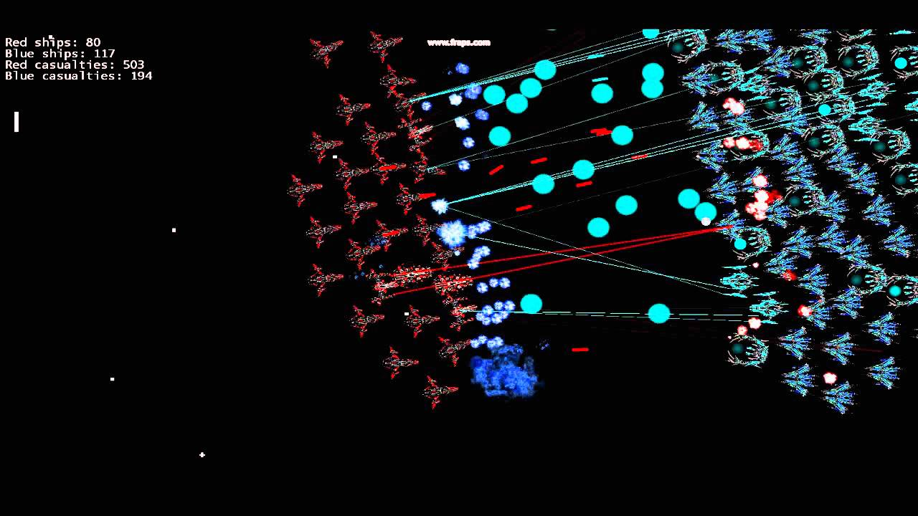
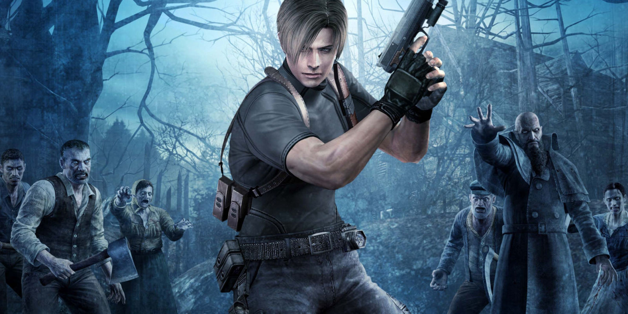
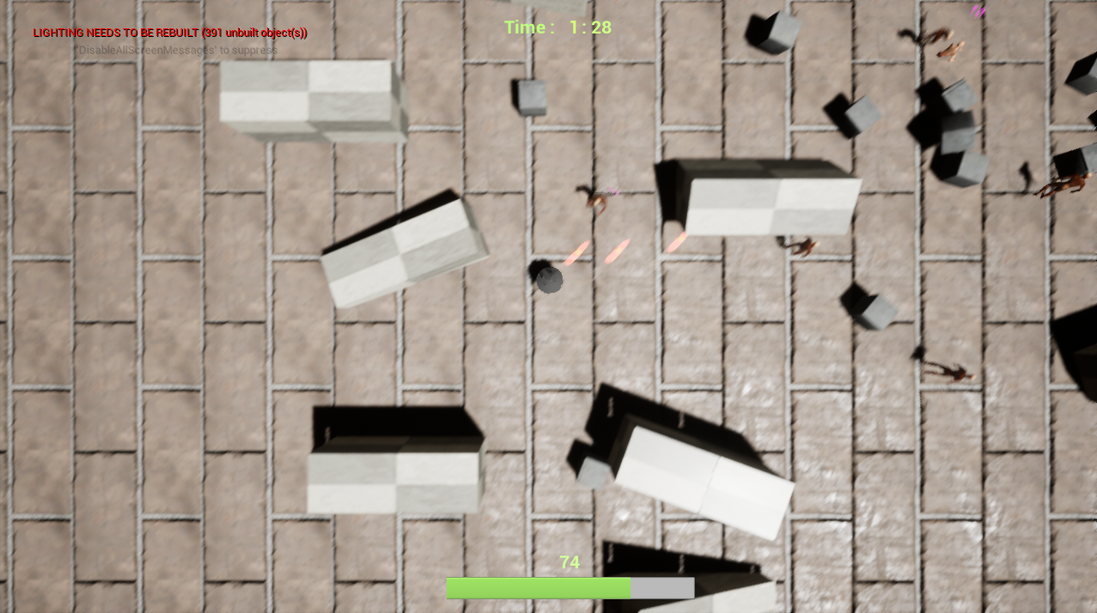
Background
Resident evil
spaceship fighting game
Zombie City
Notes:
Zombie City is a third-person shooting game through the keyboard control to defeat the zombie and get the score. Player will control the spaceship and attack the zombie. The ideas are come from the spaceship fighting game and the zombie topic (Resident evil), let players get the readily and excited by playing the game. However, this spaceship is not the human technology; human cannot control the spaceship higher than the limited level. So that the spaceship is not Invincible, human only use it like a tank (that’s mean it affected by terrain restrictions).

Slide 3
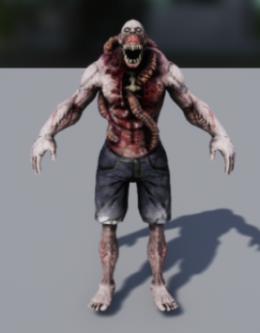
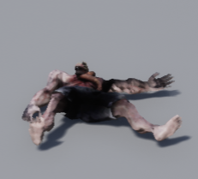
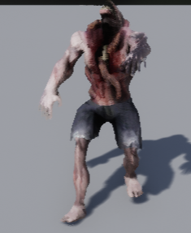
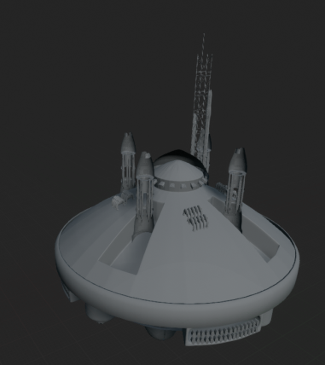
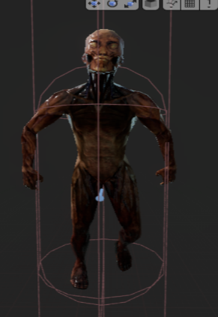
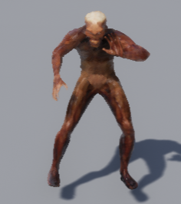
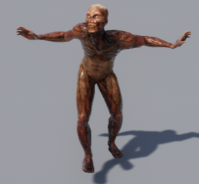
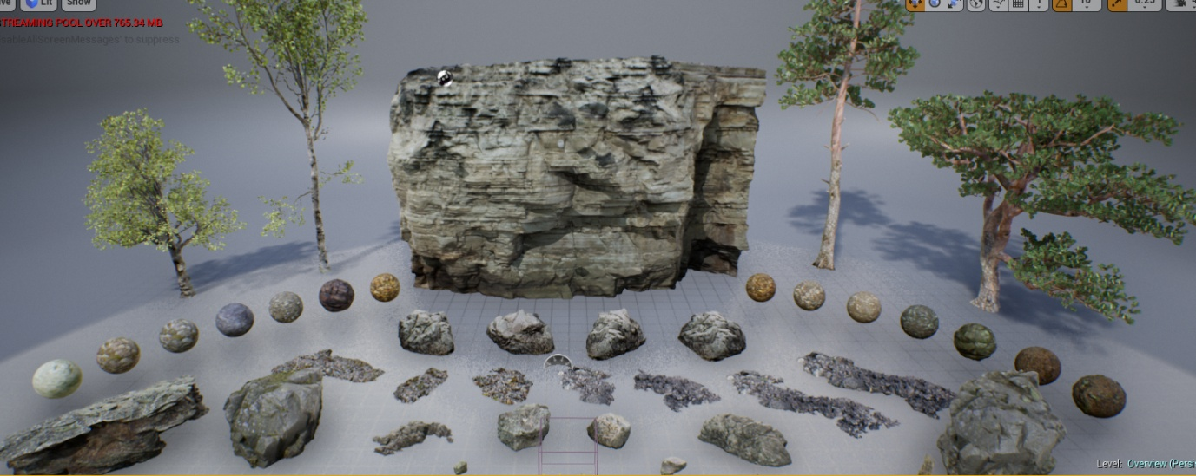
Art – Zombie/Spaceship/Map
Art from?
Notes:
Most of the art that we use are come from the free source website, it is easily to find from the internet.
This is our zombie and spaceship model. And those are the source material to build our map.

Slide 4
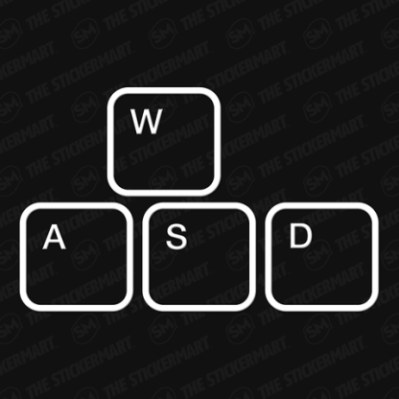
Control & Gameplay
Control method: (Moving) w, a, s, d, (shooting with direction) up, down, left and right.
Zombies lives
Notes:
By using the traditional control moving method w, a, s, d, player can easily to catch up and play.
Our shooting button will be up, down, left and right, player can shooting with any direction during moving.
Zombies will defeat by one shot and fall down. Gunshot will be making during the shooting.

Slide 5
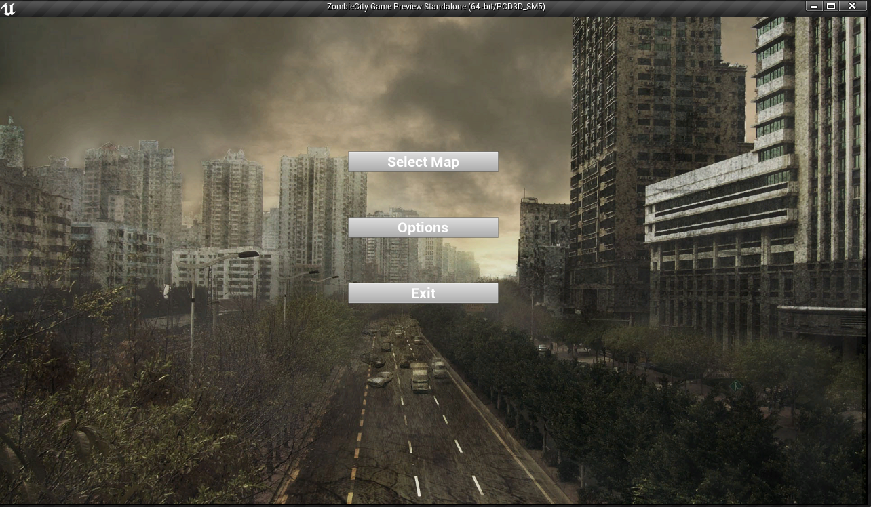
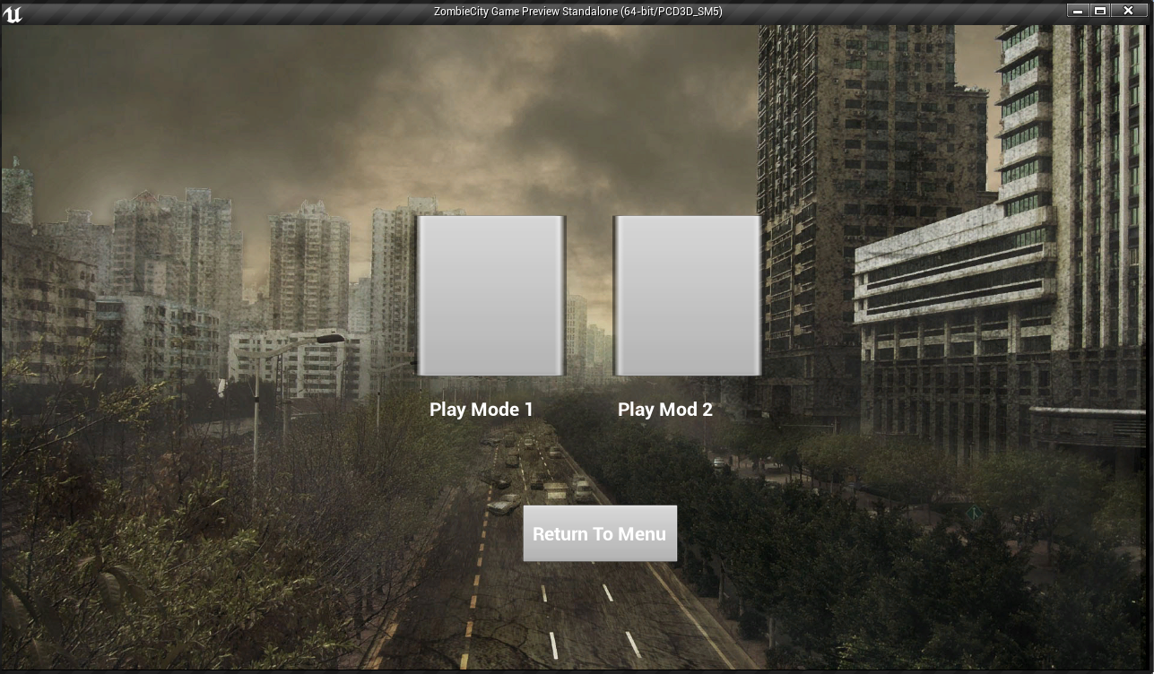
UI
Notes:
This is our UI. After clicking the select map, there will be two game mode here. The left one will go to our play mode 1 city map and the right one will be go to the play mod 2 forest map.

Slide 6
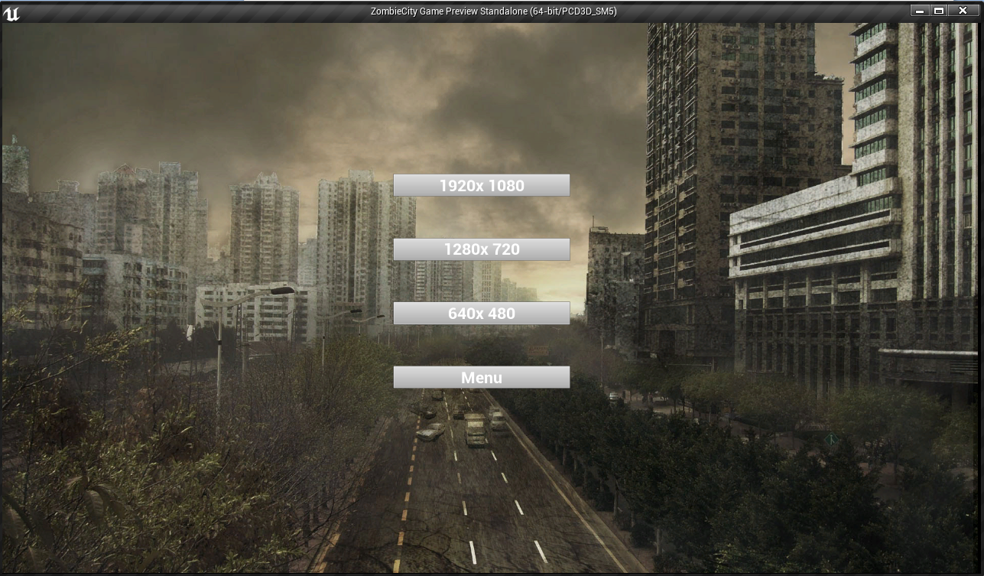
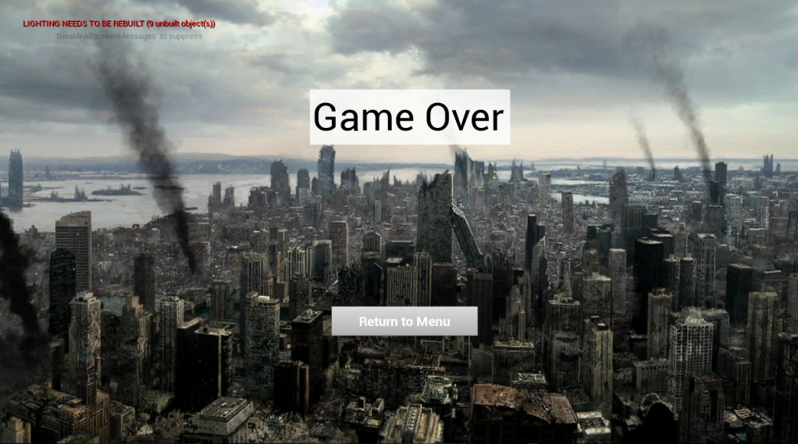
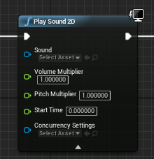
UI
Screen resolution
Music
Notes:
Player can also change their screen resolution in the option menu.
Background music will be auto play in the main menu and the game over page.

Slide 7
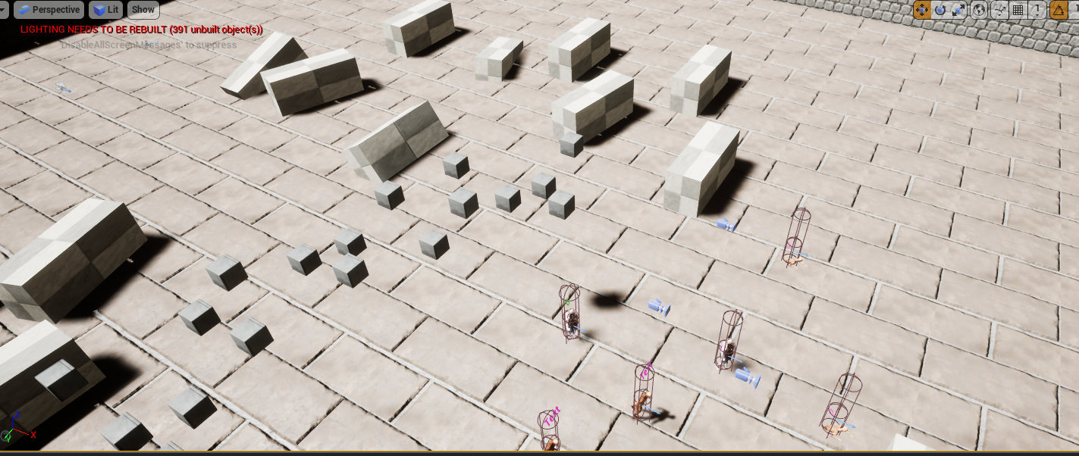
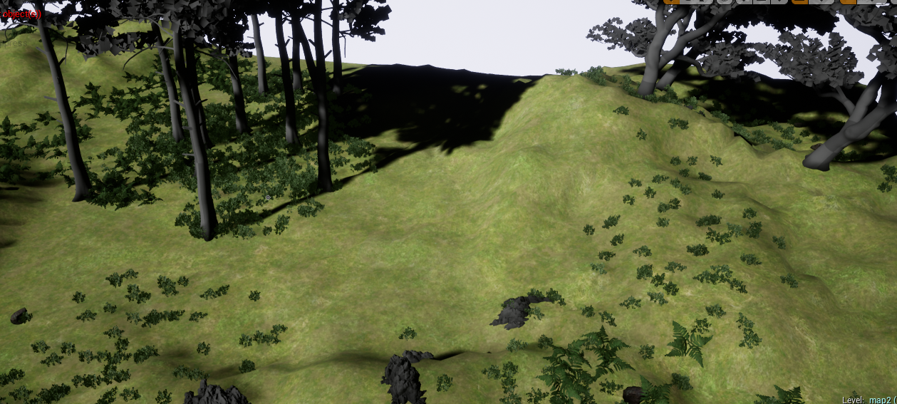
Map
City:
Forest:
Notes:
This is our map will be use in the game, we got two different environment for the player.

Slide 8

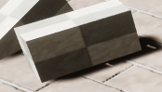
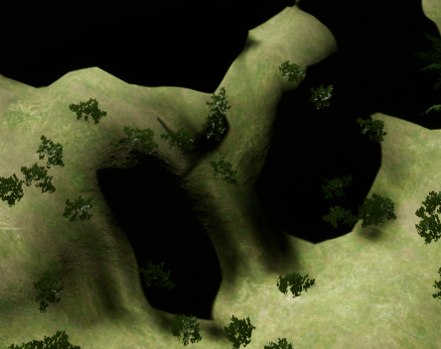
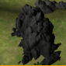
Level – Object, Collision Detection
Object in City Map:
Broken wall and stone box
Object in Forest Map:
Rock and hill
Notes:
In the city map, player may be stuck by the wall and box by the collision. Player cannot pass though the broken wall and stone box. Stone box can be shooting away to clear your way but not destroy, bullet does not have this power.
In the forest map, player cannot pass though the tree, rock and hill by the collision detected. There are a lot of terrain restrictions in this map; player may always stuck by those obstacle. This is the biggest challenge for the player.

Slide 9
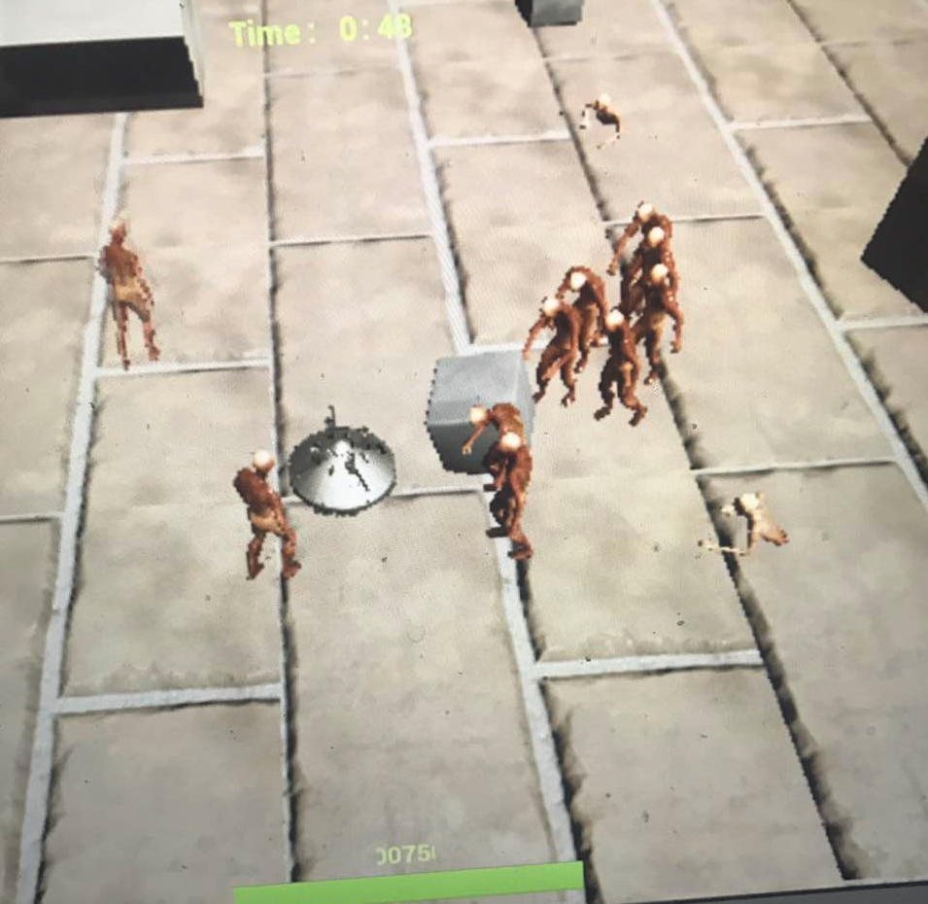
Camera
Size
Camera degree
Camera zoom
Notes:
This is the viewpoint in the game. The reason why we set the camera in this angle degree and distance because it is more comfort for the player to see the enemy and themselves.
If we set the camera too high, player will hard to see the enemy and the spaceship. Sometime the game will be easier by excessively broad.

Slide 10
Play mode 1
City Map
Notes:
Players can control the spaceship to shooting the zombie and get the score by using the control method.
When zombies are attack the spaceship, life will be loss. Also, when the spaceship lives become zero, the game is over.

Slide 11
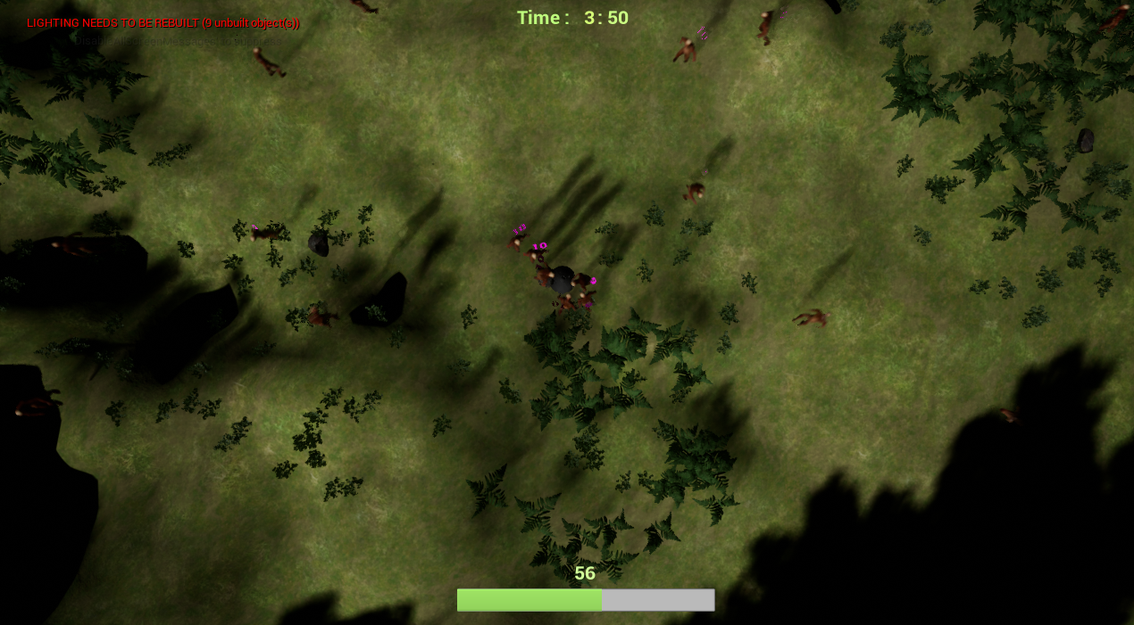
Play mode 2
Forest Map
Notes:
The same control method with the single player mode. However, player has to survive within 5 min to win the game.
In this map, there have lot of object will block your way like rock and hill. Player may be stuck in the corner or by the zombies; the difficulty will be higher in this mode.

Slide 12
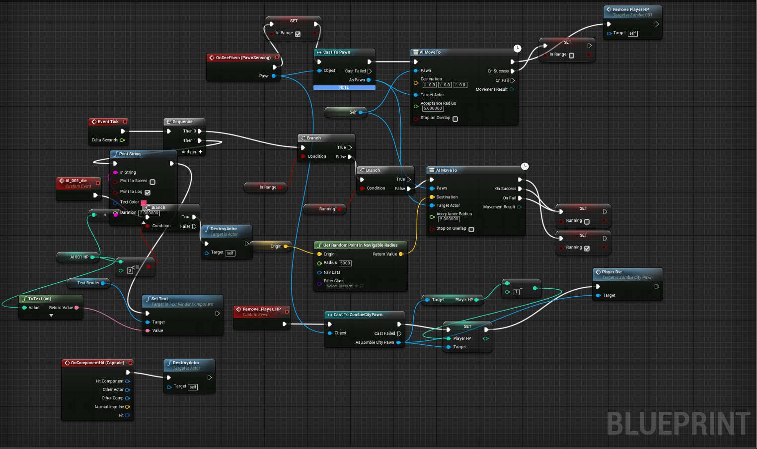
AI
Random point for Zombie appear
Random patrol
Notes:
Let’s talk about the AI section for our game. We created a method for the zombies will be appear in random point, by the time go though, it will increase the amount of enemies.
Some of the Zombies will do the random patrol, actually just keep walk around until some condition start.

Slide 13
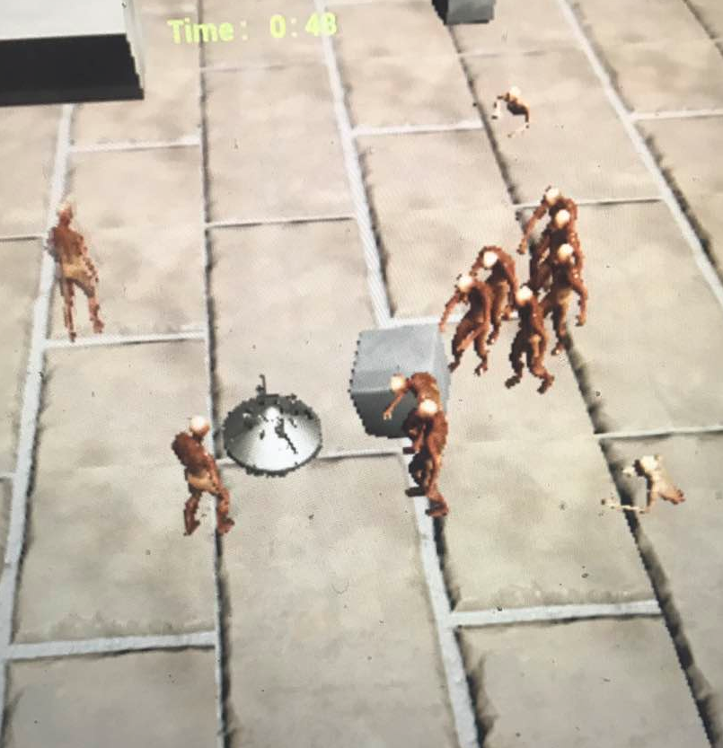
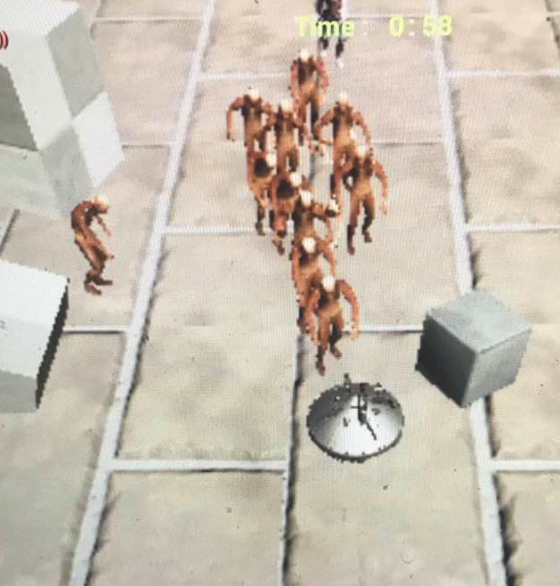
AI
Chase and attack
Zombies are non-transited
Notes:
Zombies will chase the player and attack him by some condition. While the spaceship is in front of the zombie, zombie will start chasing the spaceship and attack it.
Also, zombies are non-transited; player may be stuck by the zombies.

Slide 14
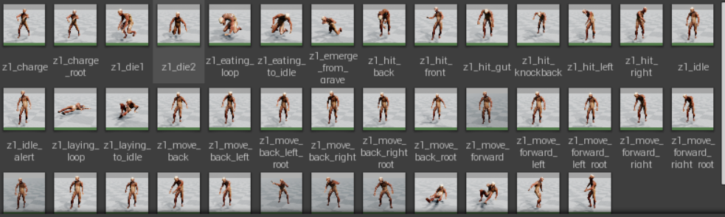
Challenge
AI – AI custom filed
AI animation
Notes:
The biggest challenge we faced was the AI setting. That is the most difficult part in our game project. It take lot of time for us to figure out the problem. For example, triggering different AI animation in different situations, and when the player appears in the AI custom field of view. Hope you guys enjoying our presentation. Thank you!

